Slide 1




Top 50 best Netflix Movies Analysis
This analysis examines the top 50 best Netflix movies based on IMDb ratings, revealing the trends and insights behind the platform's most acclaimed films.

Slide 2


Movies with IMDB rate > 8.5
Interstellar (2014) 169m
Imdb rate: 8.7/10
Genre: Adventure, Drama, Science Fiction
Spider-Man: Across the Spider-Verse (2023) 140m
Imdb rate: 8.7/10
Genre: Animation, Action, Adventure

Slide 3




Movies with IMDB rate < 5.7
The Six Triple Eight (2024) 127m
Imdb rate: 5.6/10
Genre: Drama, War
The Union (2024) 109m
Imdb rate: 5.5/10
Genre: Action, Comedy
Afraid (2024) 84m
Imdb rate: 5.1/10
Genre: Horror, Science Fiction, Thriller
The Deliverance (2024) 112m
Imdb rate: 5.1/10
Genre: Horror, Thriller

Slide 4


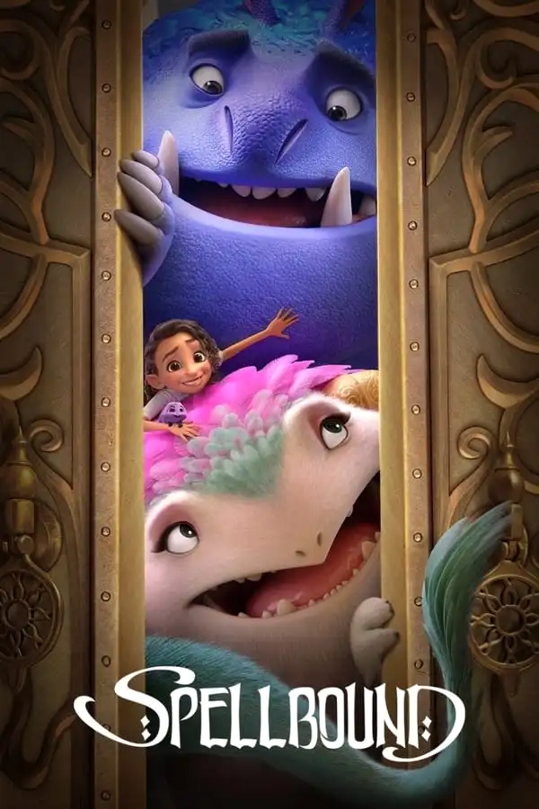







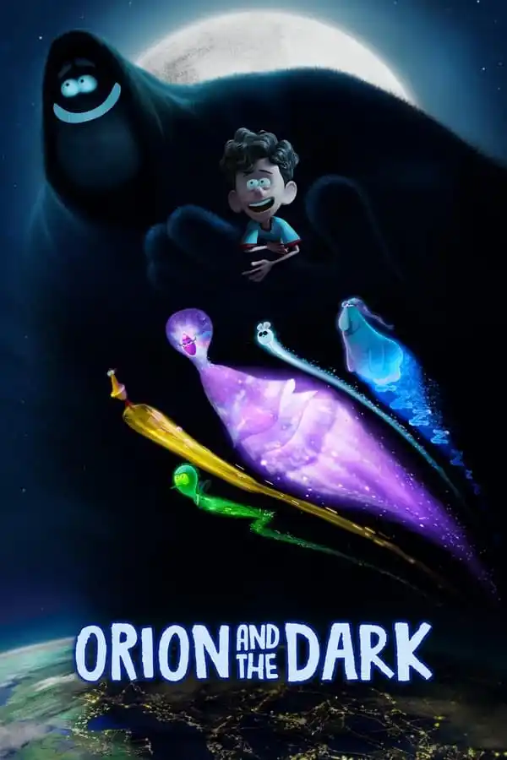




Movies with Comedy Genre

Slide 5
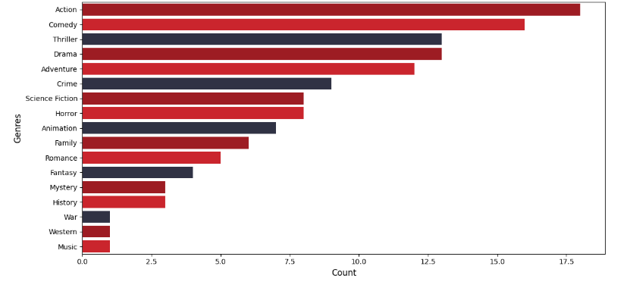
Genre Distribution Plot

Slide 6
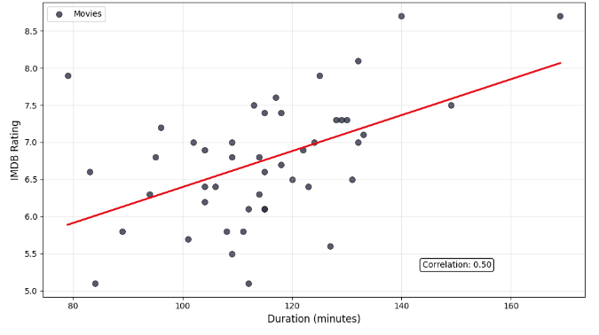
IMDb Rating Vs Duration Plot

Slide 7
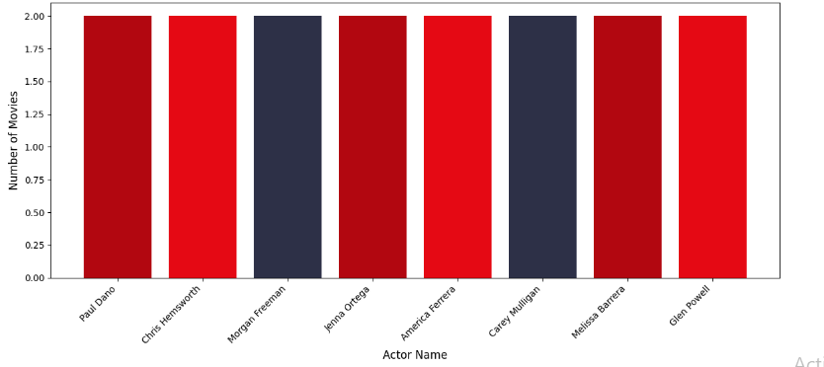
Top 8 Actors by Number of Movies Plot

Slide 8
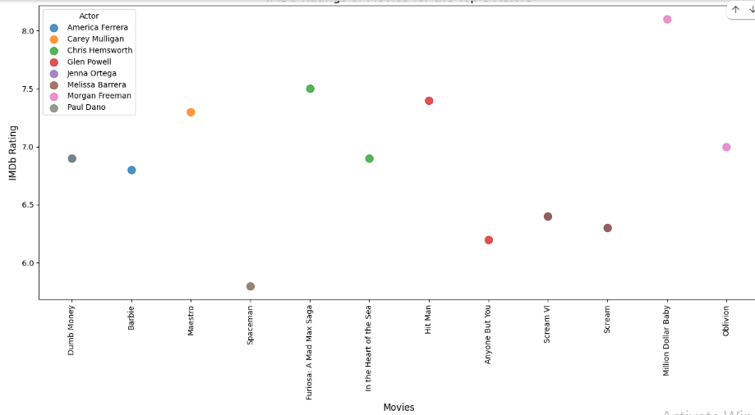
IMDb Ratings of Movies for Top 8 Actors (by number of movies)

Slide 9
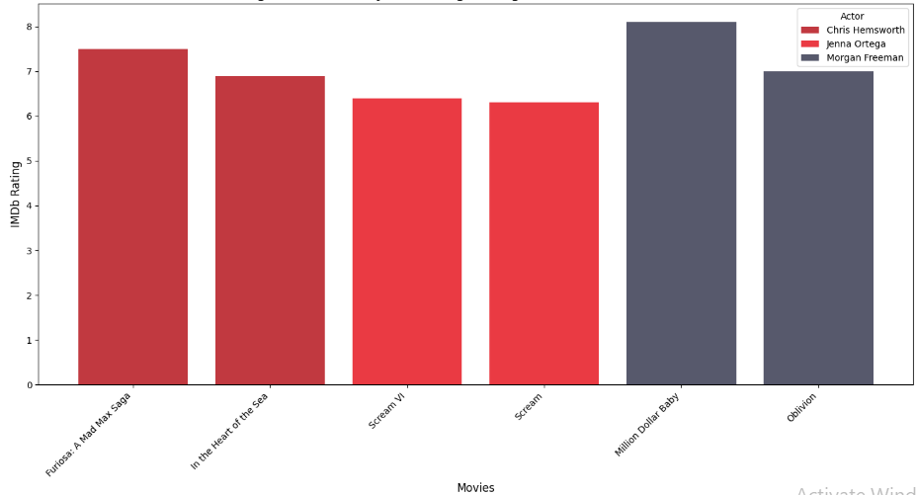
IMDb Ratings for Movies of Jenna Ortega, Morgan Freeman, and Chris Hemsworth

Slide 10
The End
Source URL:
https://www.digitaltrends.com/movies/best-movies-on-netflix-version-1735914947-2-2/#dt-heading-other-netflix-movies

